Slide 1
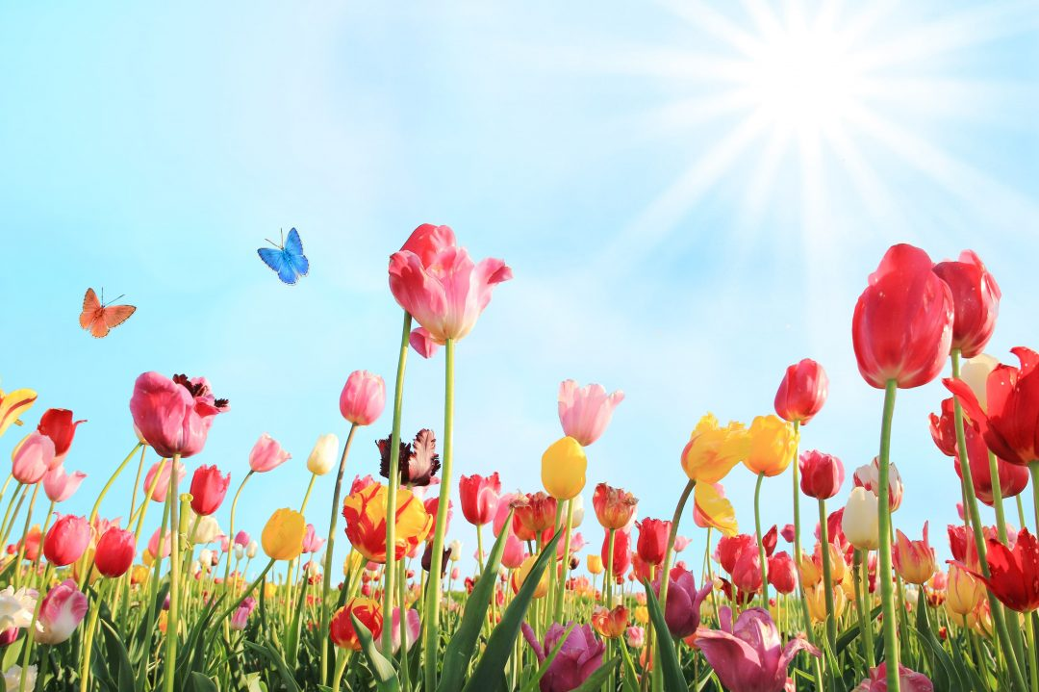

Friday, May 2 (9AM-6PM)
Saturday, May 3 (9AM-4PM)
St. Mary Anne’s Episcopal Church
315 South Main Street, North East, MD. 21901

